Slide 1


LIBRARY MANAGEMENT SYSTEM
A DIGITAL SOLUTION FOR EFFICIENT LIBRARY OPERATIONS

Slide 2


A Case Study Presented by:
Name Regd No.
ROJALIN BISWAL 2401080034
GOLDI KUMARI 2401080041
PARVINDER KAUR 2401080044
MANYATA BEHRA 2401080056

Slide 3


CONTENT
INTRODUCTION
TECHNOLOGY STACK
ADVANTAGES OF THE PROPOSED SYSTEM
ALGORITHM OVERVIEW
FLOWCHART
HEADER FILES USED
CODE IMPLEMENTATION (OVERVIEW)
EXPECTED OUTPUT
CONCLUSION
REFERENCES

Slide 4
INTRODUCTION
A Library Management System (LMS)
is software that manages library
operations, allowing users to borrow,
return, and search books efficiently.
It replaces traditional manual
cataloging with a digital system
for better accuracy and accessibility.

Slide 5


TECHNOLOGY STACK
Frontend: HTML, CSS, JavaScript
Backend: C Language
Database: Oracle
Purpose: Ensures smooth user experience, fast processing, and secure data management

Slide 6
ADVANTAGES OF THE PROPOSED SYSTEM
Automation: Reduces manual effort.
• Efficient Book Management: Tracks books efficiently.
• User-friendly Interface: Web-based for easy use.
• Data Security: Oracle ensures secure data storage.
• Faster Processing: C backend enhances speed.
• Multi-User Access: Supports students, librarians, admins.
• Report Generation: Provides analytical insights.

Slide 7
ALGORITHM OVERVIEW
Step 1: Start
Step 2: Initialize variables & structure
Step 3: Display menu options
Step 4: Process user inputs (Add, Search, Display, Count, Exit)
Step 5: Execute user-selected action
Step 6: Repeat until exit

Slide 8
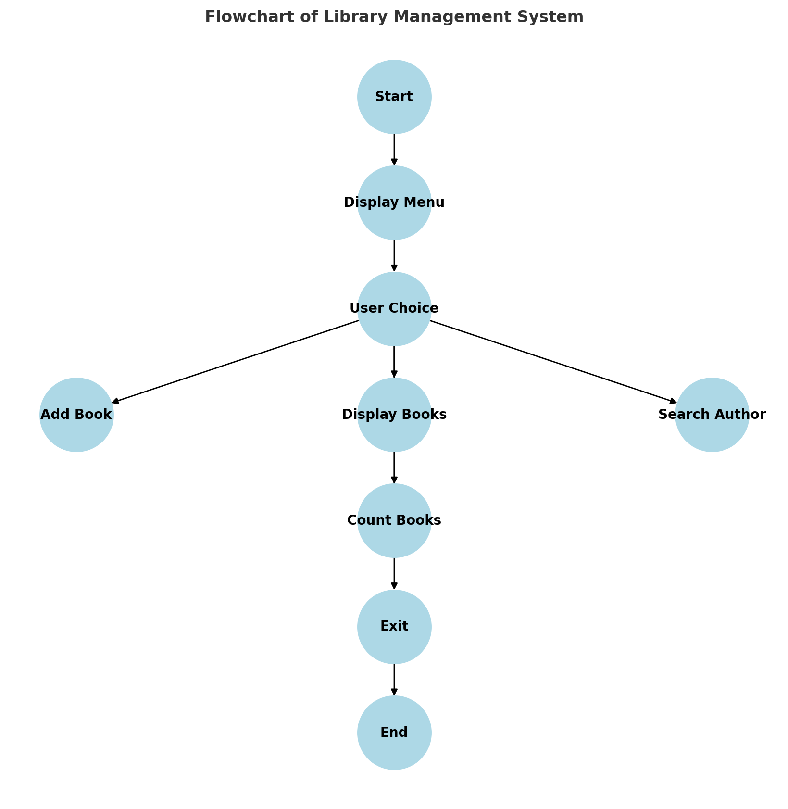
FLOWCHART

Slide 9

HEADER FILES USED
#include <stdio.h>: For input/output operations.
#include <stdlib.h>: For memory allocation and general utilities.
#include <string.h>: For string manipulation functions.

Slide 10
CODE IMPLEMENTATION (OVERVIEW)
Uses a structure to store book details.
Implements functions to add, display, search, and count books.
Uses string manipulation for author searches.
Implements a menu-driven approach for user interaction.

Slide 11
EXPECTED OUTPUT
Add a book: Successfully stores book details.
Display books: Lists all available books.
Search books: Finds books by a specific author.
Count books: Shows total books in the library.
Exit: Terminates the program safely.

Slide 12
CONCLUSiON
The Library Management System automates library operations, enhancing efficiency and user experience. It enables smooth book transactions, secure data storage, and multi-user access. The system reduces manual efforts, minimizes errors, and provides analytical reports for better management.

Slide 13
REFERENCES
Geek For Geeks
Code With C
GitHub Repository
The C Programming Book (3rd Edition) by
Ashok N. Kamthane.

Slide 14

THANK YOU

